Slide 1
Processing Sound Ranges part 1
Barb Ericson
Georgia Institute of Technology
Sept 2005

Slide 2
Learning Goals
Processing ranges of Sound values
  Creating a sound clip
  Splicing sounds together
Computing concepts
  Looping through a range
  Returning a value from a method
  Change more than one variable in a for loop

Slide 3
Creating a Sound Clip
To clip the “This” out of “This is a test”.
  Determine where it starts and stops
  Using the sound explorer:
    String file = FileChooser.getMediaPath(“thisisatest.wav”);
    Sound s = new Sound(file);
    s.explore();

Slide 4
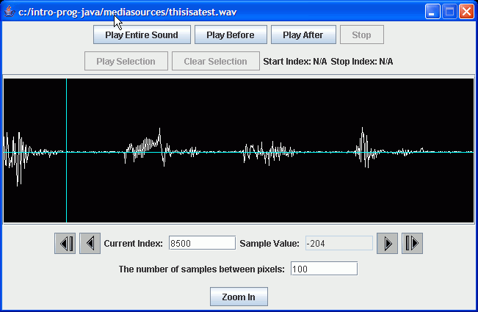
Finding the End of the This
Play before bar to check
Position the bar
Get the index

Slide 5
To Create a Sound Clip
Create a new Sound object
  Of the appropriate size
    Ending value – starting value + 1
Loop from start to end (inclusive)
  for (int x = start; x <= end; x++)
Use getSampleValueAt(index)
  And setSampleValueAt(index,value);
Return the new sound object

Slide 6
Clip Method
public Sound clip(int start,
int end)
{
// calc the num samples
int numSamples =
end - start + 1;
Sound target =
new Sound(numSamples);
int value = 0;
int targetIndex = 0;
// copy from start to end
for (int i = start; i <= end;
i++, targetIndex++)
{
value = this.getSampleValueAt(i);
target.setSampleValueAt(targetIndex,
value);
}
return target;
}

Slide 7
Testing the Clip Method
String file = FileChooser.getMediaPath(
“thisisatest.wav”);
Sound s = new Sound(file);
Sound s2 = s.clip(0,8500);
s2.write(
FileChooser.getMediaPath(“this.wav”));
s2.play();

Slide 8
Challenge
Create a clip of “is” from thisisatest.wav
Determine where to start and end the clip
Create the clip
Write it to a file

Slide 9
Returning a Value from a Method
To return a value from a method
  Include a return statement in the body of the method
  The type of the thing being returned must match the declared return type
  The clip method declared that it returned a Sound object
  The return statement returned the target Sound object
  If the types don’t match you will get a compile error

Slide 10
Splicing Sounds Together
Originally meant cutting the sound tape into segments and then assembling them in the right order
Easy to do digitally
Copy more then one sound into a target sound
  Track the source index and target index

Slide 11
Splice Method
public void splice()
{
Sound sound1 = new Sound(FileChooser.getMediaPath(“guzdial.wav”));
Sound sound2 = new Sound(FileChooser.getMediaPath("is.wav"));
int targetIndex = 0; // the starting place on the target
int value = 0;
// copy all of sound 1 into the current sound (target)
for (int i = 0;
i < sound1.getLength();
i++, targetIndex++)
{
value = sound1.getSampleValueAt(i);
this.setSampleValueAt(targetIndex,value);
}

Slide 12
Splice Method - Continued
// create silence between words by setting values to 0
for (int i = 0;
i < (int) (this.getSamplingRate() * 0.1);
i++, targetIndex++) {
this.setSampleValueAt(targetIndex,0);
}
// copy all of sound 2 into the current sound (target)
for (int i = 0;
i < sound2.getLength();
i++, targetIndex++) {
value = sound2.getSampleValueAt(i);
this.setSampleValueAt(targetIndex,value);
}
}

Slide 13
Testing the Splice Method
String silence = FileChooser.getMediaPath(
"sec3silence.wav");
Sound target = new Sound(silence);
target.explore();
target.splice();
target.explore();

Slide 14
Summary
You can work with ranges by changing the start and end value of an index in a loop
You can return a value from a method
  Declare the return type
  Use a return statement
You are not required to change a variable in a for loop
  But you can change more than 1

